Slide 1

A PROJECT IDEA PRESENTATION ON
FlowML
Visual AI‑Powered Machine Learning Pipeline Builder
Presented by :
Team AutoNova
KIT’s College of Engineering, Kolhapur

Slide 2

List of
Contents
  Introduction
  Problem Statement
  Objectives
  Proposed System
  System Architecture
  Tech Stack
  Use Case
  Conslusion

Slide 3
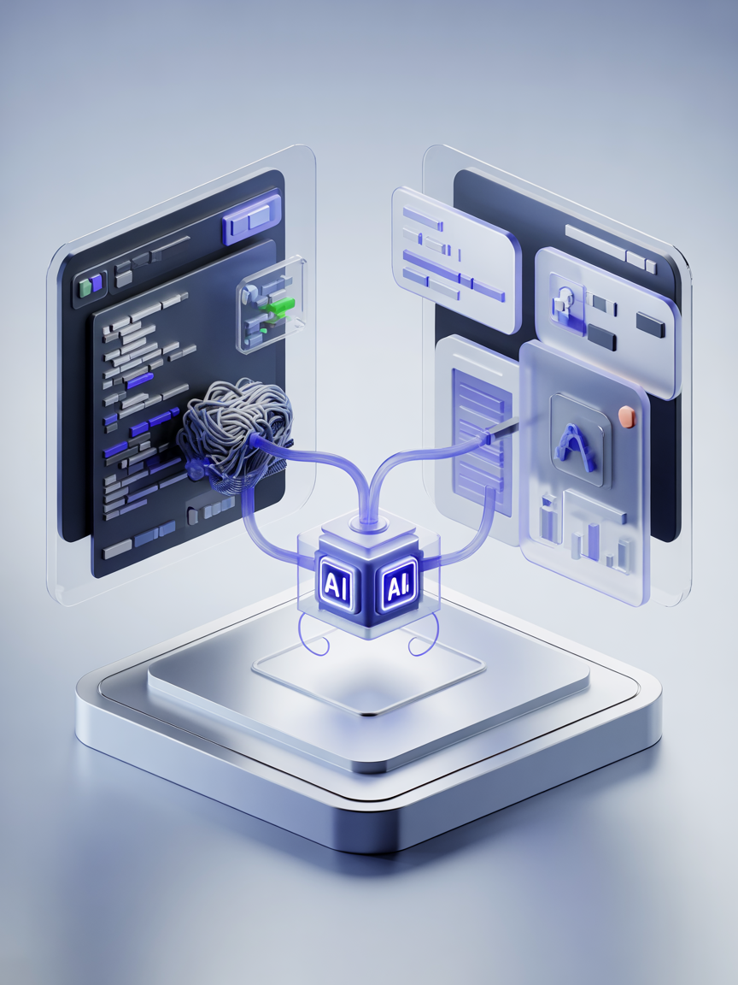
Introduction
  Machine learning enables intelligent decision-making, but building complete workflows requires technical expertise and multiple tools, making the process complex.
  Managing steps like preprocessing, training, and evaluation separately increases development time and reduces productivity.
  Beginners often struggle to understand how different stages of a machine learning pipeline connect.
  FlowML provides a visual drag-and-drop interface to automate preprocessing, model selection, and evaluation.
  This simplifies machine learning workflows, improves productivity, and makes AI accessible to more users.

Slide 4
Problem Statement
Challenges
Solution Vision
  Machine learning pipelines involve multiple complex steps requiring strong technical expertise and experience.
  Beginners struggle to understand workflows, while professionals lose time switching between multiple tools.
  A unified visual platform simplifies machine learning workflows and reduces technical complexity and effort.
  Users build pipelines faster with automation, improving productivity and reducing development time.

Slide 5
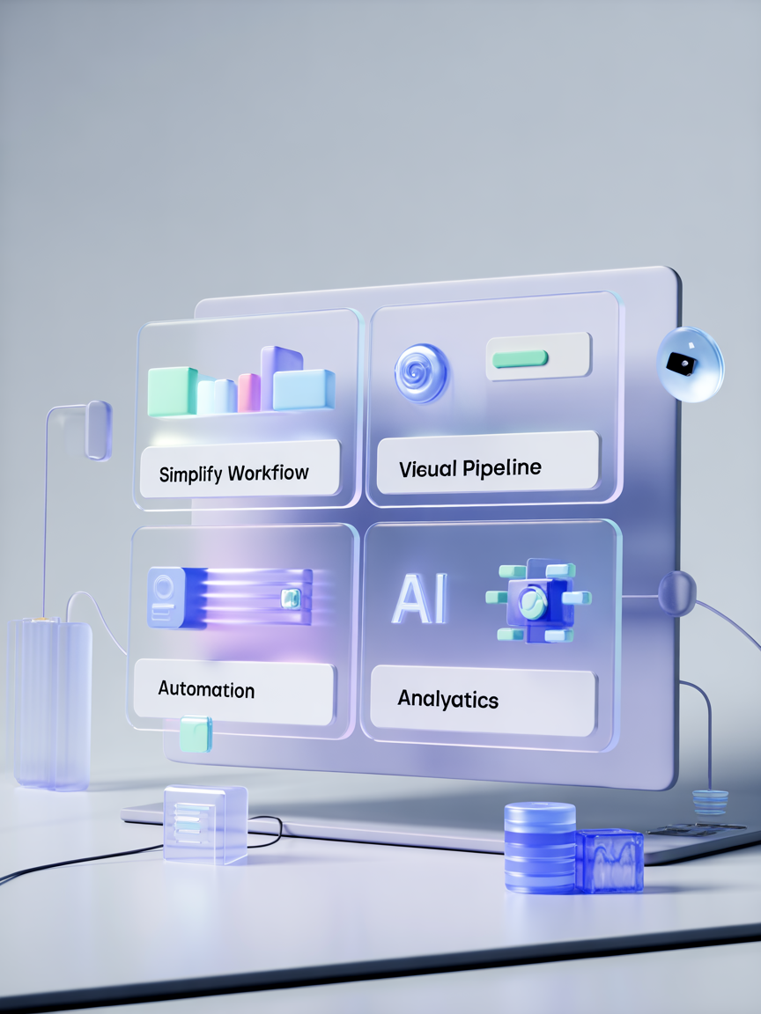
Objectives
🎯 Simplify
⚙️ Automate
Simplify end-to-end machine learning workflows, improving productivity and reducing development time.
Automate preprocessing and model selection, reducing manual effort and improving efficiency.
🧩 Visualize
📊 Analyze
Enable visual drag-and-drop pipeline building, simplifying workflow design and model development.
Provide model comparison and performance insights, supporting better decision -making.

Slide 6
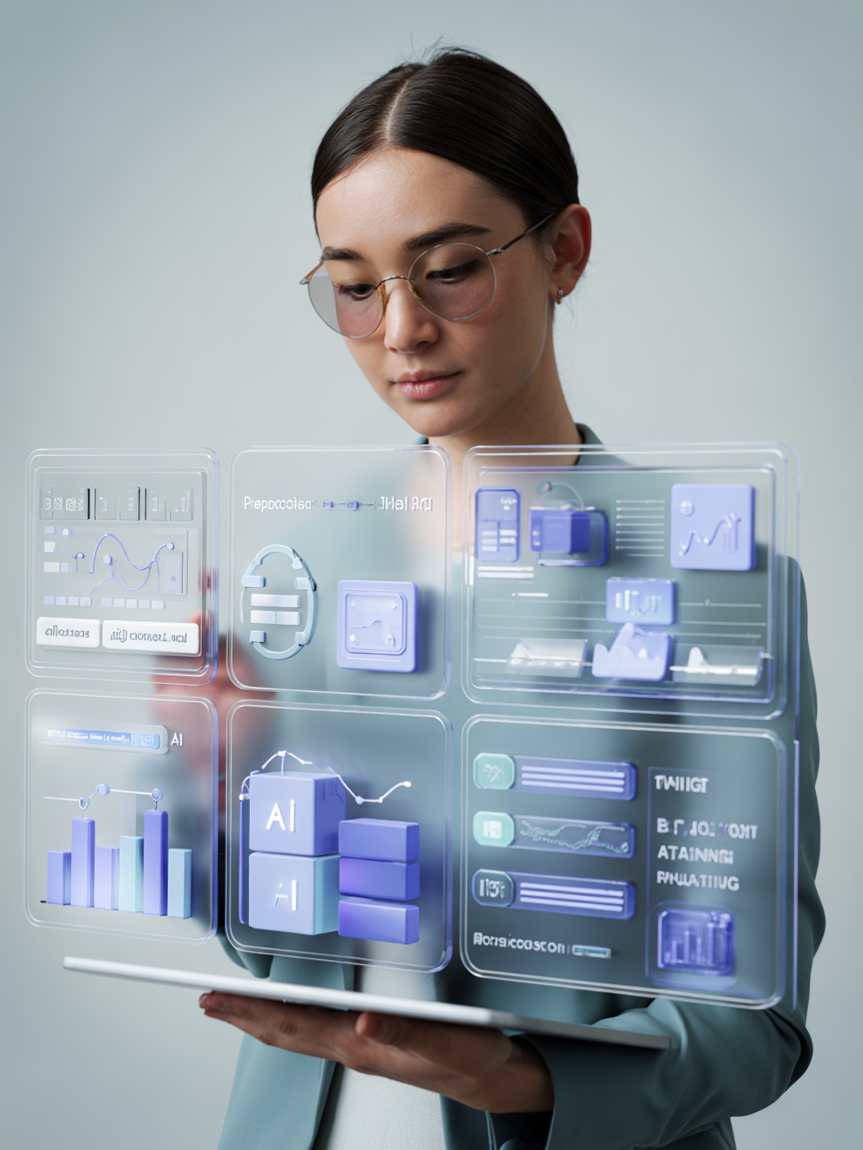

Proposed
System
  FlowML provides a drag-and-drop interface to build complete machine learning pipelines by connecting dataset upload, preprocessing, model training, and prediction in a single workflow.
  The platform automatically analyzes datasets, handles missing values, trains multiple models, and selects the best-performing model based on evaluation metrics.
  FlowML also generates visual insights such as correlation analysis, feature importance, and performance charts, while enabling predictions and model export for end-to-end workflow execution.

Slide 7
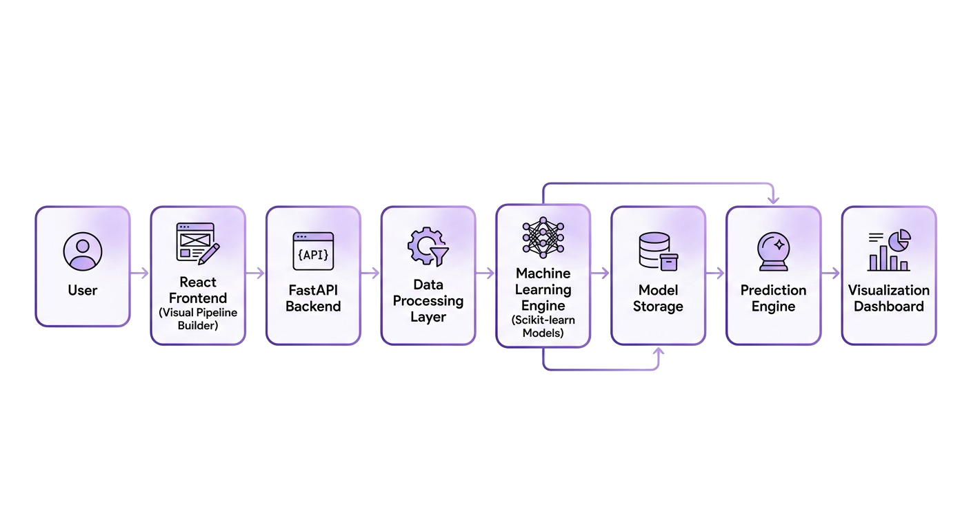
System Architecture
Architecture Components:
• React Frontend - Visual pipeline builder interface
• FastAPI Backend - Workflow execution and API handling
• Data Processing Layer - Dataset preprocessing engine
• Machine Learning Layer - Scikit‑learn model training
• Visualization Layer - Charts and insights dashboard

Slide 8

Tech Stack
Backend Tech
  FastAPI
  Python
  REST APIs
  Async Processing
  Modular Architecture
Modern tools and frameworks enabling seamless, scalable, and efficient FlowML development.
Frontend Tech
Machine Learning
  React
  Tailwind CSS
  React Flow
  Framer Motion
  Modern UI Components
  Scikit-learn
  Pandas
  NumPy

Slide 9
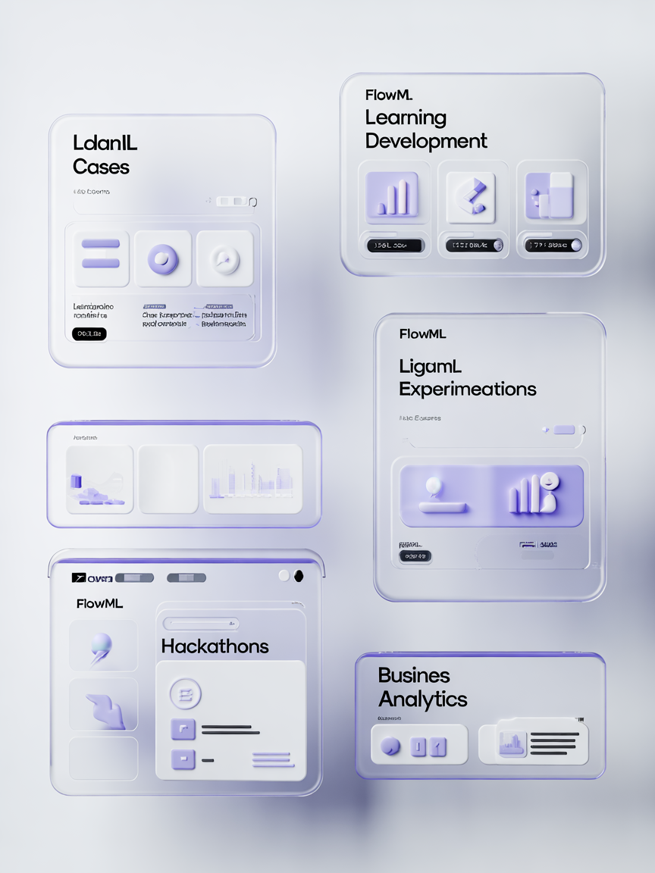
Use Cases
🎓 Learning
📊 Experimentation
Students learn machine learning concepts through visual workflows and hands-on experimentation.
Data scientists perform rapid experimentation and compare multiple models efficiently.
💻 Development
🏢 Analytics
Developers build machine learning applications faster using simplified pipeline creation.
Organizations build prediction systems for business analytics and data-driven decisions.

Slide 10
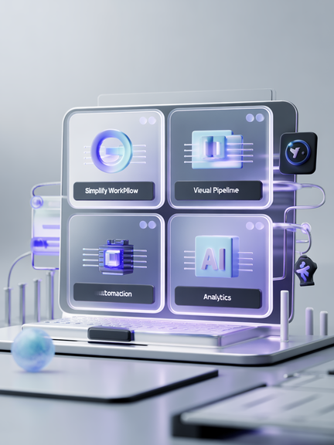
Conclusion
  FlowML simplifies machine learning development with a visual workflow platform that reduces technical complexity. The drag-and-drop builder allows users to create pipelines without extensive coding.
  The platform automates preprocessing, model training, and evaluation, enabling faster experimentation and improved productivity.
  FlowML also provides visual insights and prediction capabilities, making machine learning more accessible, efficient, and scalable.

Slide 11
Our Team
Ajinkya Walvekar
Vishwajeet Chandole
Backend & ML Integration
Frontend & UI Development
Aditya Hajare
Prathmesh Kagale
Testing & Pipeline Design
Research & Documentation

Slide 12
Thank You
FlowML - Visual Machine Learning Platform

